Slide 1

Wireless Network
PMIT-6217
By-
Dr. Jesmin Akhter
Professor
Institute of Information Technology
Jahangirnagar University

Slide 2
Lecture 01and 02 Introduction to Wireless Network

Slide 3
Contents
The course will mainly cover the following topics:
Wireless Networking
Multiple Access techniques for wireless Communications
Modulation Techniques for mobile radio
The Cellular Concepts

Slide 4
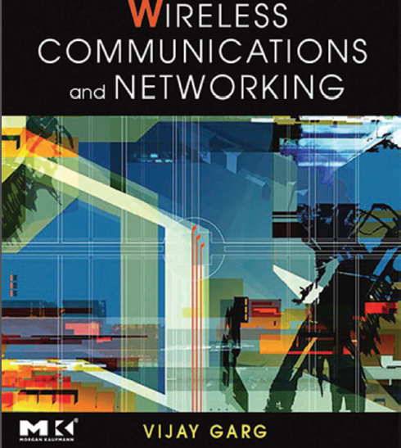
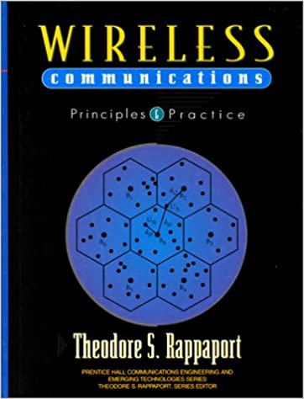
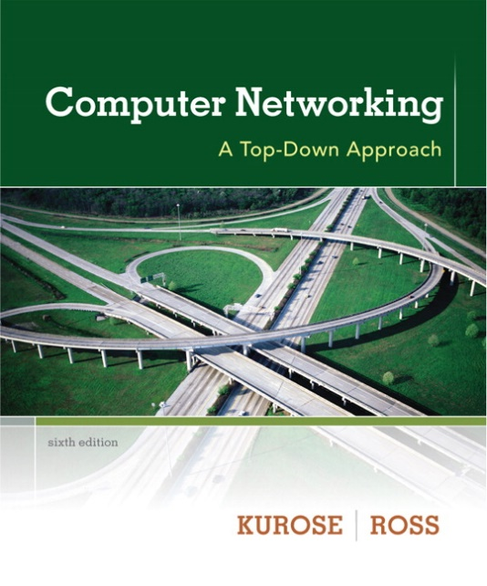
Text Book Wireless Communications and Networking Vijay K. Garg
Text Book Wireless Communications Rappaport
Computer Networking: A Top Down Approach 6th edition Jim Kurose, Keith Ross Addison-Wesley

Slide 5
Schedule
Continue from 09.06.2023--------
Every week
Friday
From 2:30 PM-4:30 PM / 4:30 PM-6:30 PM
NB: Schedule may change

Slide 6
Grading Policy
Attendance =10%
Exercise test =10%
Instant test
Assignment
Presentation
Class Test (Average of two) =20%
Final Examination =60%
================================
=100%

Slide 7
Exam schedule
Tutorial | Date and Time
Tutorial-01 | After 3 classes
Tutorial-02 | After 6 classes
Tutorial-03 | After 9 classes
NB: Schedule may change

Slide 8
Outline
Introduction
Wireless networking,
Limitations of wireless networks
Some open research topics
Wireless Network Classification
Wireless Networking
Wireless LAN Technologies

Slide 9
Wireless Network
Wireless networks are networks that use radio waves to connect devices , without the necessity of using cables of any kind.
The basis of wireless systems are radio waves, an implementation that takes place at the physical level of network structure.
Radio frequency (RF) is any of the electromagnetic wave frequencies that lie in the range extending from around 3 kHz to 300 GHz
In radio and electronics, an antenna is an electrical device which converts electric power into radio waves, and vice versa.
Notes:
Wireless networks use radio waves to connect devices such as laptops to the Internet, the business network and applications.

Slide 10
Wireless Network
Wireless Network
Radio waves propagate through space as travelling electromagnetic waves. The energy of signals exists in the form of electrical and magnetic fields. Both electrical and magnetic fields vary sinusoidally with time.
The two fields always exist together because a change in electrical field generates a magnetic field and a change in magnetic field develops an electrical field. Thus there is continuous flow of energy from one field to the other.

Slide 11
Wireless Network
Devices commonly used for wireless networking include
Sensor, Embedded controllers, portable computers, desktop computers, hand-held computers, personal digital assistants (PDAs), cellular phones, pen-based computers, and pagers. Wireless networks work similar to wired networks, however, in case of wireless networks, transmitting and receiving data are more challenging.
Notes:
A personal digital assistant (PDA), also known as a handheld PC, is a variety mobile device which functions as a personal information manager. Personal digital assistants were designed to replace non-electronic day planners. Many PDAs can work as an address book, a calculator, a clock, and a calendar. Some also have games on them. Newer PDAs are now called smartphones and have Wi-Fi, touch screens, can read e-mail, record video, play music and make phone calls.
A pager (also known as a beeper or bleeper^{[1]}) is a wireless telecommunications device that receives and displays alphanumeric or voice messages. One-way pagers can only receive messages, while response pagers and two-way pagers can also acknowledge, reply to and originate messages using an internal transmitter.^{[2]}

Slide 12
Devices commonly used for wireless networking
Sensor: A very simple wireless device is represented by a sensor transmitting state information. One example could be a switch sensing the office door. If the door is closed, the switch transmits this to the mobile phone inside the office. Without user interaction, the semantics of a closed door is applied to phone calls.
Embedded controllers: Many appliances already contain a simple or some times more complex controller. Keyboards, mice, headsets, washing machines, coffee machines, hair dryers and TV sets are just some examples.
Pager: As a very simple receiver, a pager can only display short text messages, has a tiny display, and cannot send any messages. Pagers can even be integrated into watches.
One-way pagers can only receive messages, while response pagers and two-way pagers can also acknowledge, reply to and originate messages using an internal transmitter.

Slide 13
Devices commonly used for wireless networking
Personal digital assistant: PDAs typically accompany a user and offer simple versions of office software (calendar, note-pad, mail). The typical input device is a pen, with built-in character recognition translating handwriting into characters. Web browsers and many other software packages are available for these devices.
Pocket computer: The next steps toward full computers are pocket computers offering tiny keyboards, color displays, and simple versions of programs found on desktop computers (text processing, spreadsheets etc.).
Notebook/laptop: Finally, laptops offer more or less the same performance as standard desktop computers; they use the same software – the only technical difference being size, weight, and the ability to run on a battery. If operated mainly via a sensitive display (touch sensitive or electromagnetic), the devices are also known as notepads or tablet PCs.

Slide 14
Why Wireless?
Why do we need a new technology when we have such a developed public telephone network.
Ease of deployment:
Wireless network can be easily installed
No running media cables between Transceivers
Cost
Inexpensive
Ease of use:
Use from anywhere
Allows multiple devices to simultaneously use the same wireless connection
Mobility:
Communicate while moving
Notes:
Wireless infrastructure can be built for very little cost compared to traditional wired alternatives. But building wireless networks is only partly about saving money. By providing people in your local community with cheaper and easier access to information, they will directly benefit from what the Internet has to offer. The time and effort saved by having access to the global network of information translates into wealth on a local scale, as more work can be done in less time and with less effort.
Wireless networks allow remote devices to connect without difficulty, independently these devices are a few feet or several kilometers away.
And no need to break through walls to pass cables or install connectors. This has made the use of this technology very popular, spreading rapidly.

Slide 15
Limitations of Wireless Networks
Attenuation or Signal Loss
The farther they travel, the more wireless signals begin to lose their strength. This equates to attenuation (or weakening signals).
Interference
Multipath fading
When signals are transmitted, they don’t always take a direct path. Instead, they bounce off nearby indoor/outdoor objects and reflect back at different times, which can result in signal deterioration (delayed signals all carrying the same information). Proper steps must be taken to remove those delayed signals.
Reflection Materials
Hidden node problem
Absorption Wireless Networks
Absorption is when the signal strength loses power as it passes through a medium. All materials will absorb the signal at different rates. Wood is an example of a material that can heavily absorb a signal, which can lead to problems

Slide 16
Challenges of mobility
Challenges of using a radio channel:
The use of radio channels requires methods of sharing them – channel access.
The quality of the path - a more challenging problem than with wires.
Bandwidth: it is possible to add wires but not bandwidth. So it is important to develop technologies that provide for channel reuse.
Privacy and security - a more difficult issue than with wired phone.
Others: low energy (battery), hand off, etc.

Slide 17
Some open research topics
Interference: Radio transmission cannot be protected against interference using shielding. For example, electrical devices and lightning cause severe interference and result in higher loss rates for transmitted data or higher bit error rates respectively.
Regulations and spectrum: Frequencies have to be coordinated, and unfortunately, only a very limited amount of frequencies are available (due to technical and political reasons). One research topic involves determining how to use available frequencies more efficiently, e.g., by new modulation or demand-driven multiplexing.
Low bandwidth: Transmission rates are still very low. Researchers look for more efficient communication protocols with low overhead.

Slide 18
Some open research topics
High delays, large delay variation: A serious problem for communication protocols used in today’s Internet (TCP/IP) is the big variation in link characteristics. In wireless systems, delays of several seconds can occur, and links can be very asymmetrical (i.e., the links offer different service quality depending on the direction to and from the wireless device). Applications must be tolerant and use robust protocols.
Lower security, simpler to attack: Not only can portable devices be stolen more easily, but the radio interface is also prone to the dangers of eavesdropping. Wireless access must always include encryption, authentication, and other security mechanisms that must be efficient and simple to use.
Shared medium: Although different medium access schemes have been developed, many questions are still unanswered, for example how to provide quality of service efficiently with different combinations of access, coding, and multiplexing schemes.
Ad-hoc networking: Wireless and mobile computing allows for spontaneous networking with prior set-up of an infrastructure. However, this raises many new questions for research: routing on the networking and application layer, service discovery, network scalability, reliability, and stability etc.

Slide 19
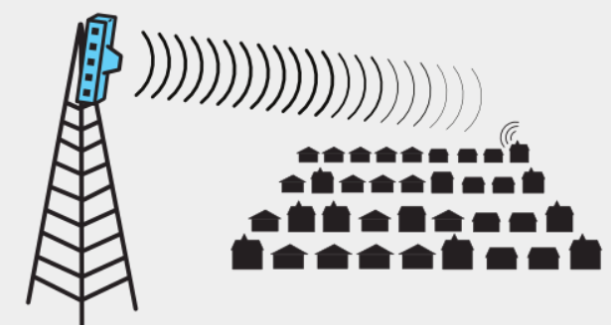
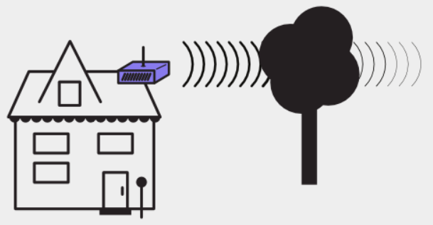
Wireless Challenges that comes up when working with wireless equipment
Each scenario presents a specific challenge or problem that comes up when working with wireless equipment. They are categorized as:
Distance — Wireless signals lose power the further they travel, no matter the type of antenna.
Line of Sight — Wireless signals can encounter total barriers, preventing connections.
Barriers — Wireless signals lose signal strength through solid objects.

Slide 20
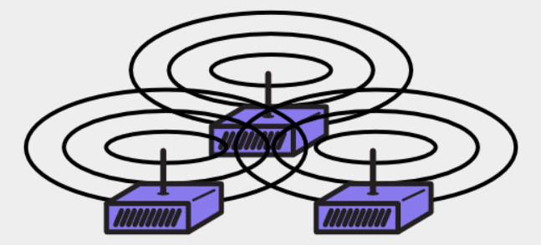
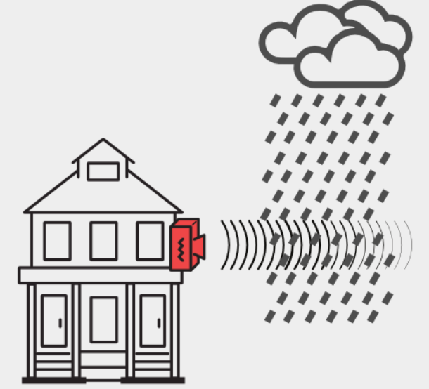
Wireless Challenges?
Wireless Challenges that comes up when working with wireless equipment
Interference — Routers can be too loud, making it impossible for them to hear each other.
Weather — Weather conditions can disrupt wireless signals.
Electrical power issues — Routers need steady electricity to work correctly.

Slide 21
Wireless network taxonomy/ classification
single hop
multiple hops
host connects to
base station (WiFi,
WiMAX, cellular)
which connects to
larger Internet
host may have to
relay through several
wireless nodes to
connect to larger
Internet
infrastructure
(e.g., APs)
no
infrastructure
no base station, no
connection to larger
Internet (Bluetooth,
ad hoc nets)
no base station, no
connection to larger
Internet. May have to
relay to reach other
a given wireless node
MANET(mobile ad hoc network ),
VANET(Vehicular Ad-Hoc Network)
Notes:
A mobile ad hoc network (MANET) is a continuously self-configuring, infrastructure-less network of mobile devices connected wirelessly. Each device in a MANET is free to move independently in any direction, and will therefore change its links to other devices frequently. Each must forward traffic unrelated to its own use, and therefore be a router. The primary challenge in building a MANET is equipping each device to continuously maintain the information required to properly route traffic.
The Vehicular Ad-Hoc Network, or VANET, is a technology that uses moves cars as nodes in a network to create a mobile network. VANET turns every participating car into a wireless router or node, allowing cars approximately 100 to 300 metres of each other to connect and, in turn, create a network with a wide range.

Slide 22
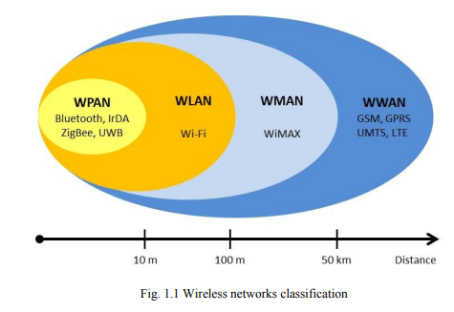
Wireless Network Classification
Wireless networks can be classified into four specific groups according to the area of application and the signal range :
Wireless Personal-Area Networks (WPAN),
Wireless Local-Area Networks (WLANs),
Wireless Metropolitan-Area Networks (WMAN),
and Wireless Wide-Area Networks (WWANs).
Notes:
GPRS - General Packet Radio Service was the evolution of 2G GSM to provide packet switched data at rates up to a maximum of 172 kbps.
GPRS was something of a revolution because all previous mobile phone systems had used circuit switched channels

Slide 23
Wireless Network Classification
Short-range wireless Network:
Local area networks (LANs), such as corporate buildings, school campuses, or homes,
Personal area networks (PANs) where portable computers within close proximity to one another need to communicate.
The above two networks typically operate over unlicensed spectrum reserved for industrial, scientific and medical (ISM) usage. The available frequencies differ from country to country. The most common frequency bands are at 2.4 GHz and at 5 GHz, which are available across most of the globe.
The availability of these frequencies allows users to operate wireless networks without obtaining a license, and without charge.

Slide 24
Wireless Network Classification
long-range wireless networks
In long-range networks, connectivity is typically provided by companies that sell the wireless connectivity as a service.
These networks span large areas such as a metropolitan area (WMAN), a state or province, or an entire country. The goal of long-range networks is to provide wireless coverage globally. The most common long-range network is wireless wide area network (WWAN).
When true global coverage is required, satellite networks are also available.

Slide 25
Wireless Personal-Area Networks (WPAN)
Wireless Personal Area Networks are based on the IEEE 802.15 standard.
Communication in a very short range, of about 10 meters.
A WPAN involves little or no infrastructure or direct connectivity to the world
Small, power-efficient, inexpensive solutions: Smartphone and a PDA.
Low power demands and a low bit rate.
Relay on technologies such as Bluetooth, IrDA, ZigBee or UWB.
From an application point of view, Bluetooth is intended for a cordless mouse, keyboard, and hands-free headset, IrDA is intended for point-to-point links between two devices for simple data transfers and file synchronization, ZigBee is designed for reliable wirelessly networked monitoring and control networks and, UWB is oriented to high-bandwidth multimedia links.
Notes:
PDA: Personal digital assistant is a term for a small, mobile, handheld device that provides computing and information storage and retrieval capabilities for personal or business use, often for keeping schedules, calendars and address book information handy.

Slide 26
Bluetooth
Bluetooth corresponds to the IEEE 802.15.1 standard.
Originally Bluetooth was designed for low power consumption, short range and omni-directional (point to multipoint) communications, and cheap devices, to be used as a cable replacement, linking devices through an ad hoc connection of radio waves.
Operates for three different classes of devices: Class 1, class 2 and class 3 where the range is about 100 meters, 10 meters and 1 meter respectively.
Using the 2.4 GHz band, two devices within the coverage range of each other can share up to 720 Kbps of capacity or transfer rate.
The most commonly used is class 2.

Slide 27
Bluetooth
A Bluetooth network is also called a piconet, and is composed of up to 8 active devices in a master-slave relationship.
The first Bluetooth device in the piconet is the master, and all other devices are slaves that communicate with the master.
A piconet typically has a range of 10 meters, although ranges of up to 100 meters can be reached under ideal circumstances.
To provide security, each link is encoded and protected against eavesdropping and interference.
Two piconets can be connected to form a scatternet.
A Bluetooth device may participate in several piconets at the same time, thus allowing for the possibility that information could flow beyond the coverage area of the single piconet.
A device in a scatternet could be a slave in several piconets, but master in only one of them.

Slide 28
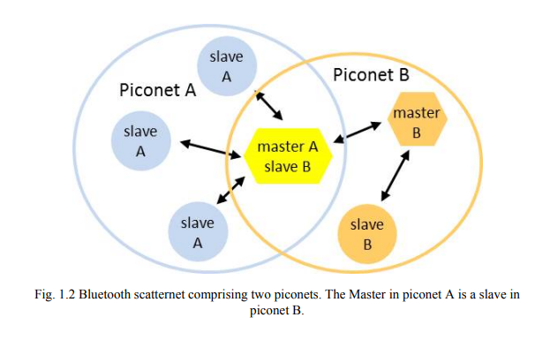
Bluetooth

Slide 29
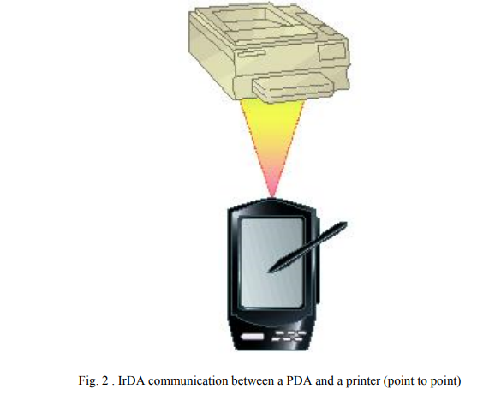
IrDA
The Infrared Data Association (IrDA) specifies a complete set of infrared communications standards.
IrDA is a low-power, low-cost, unidirectional (point to point), narrow angle (< 30º) cone, ad hoc data transmission standard designed to operate over a distance of up to 1 meter and at speeds of 9600 bps to 4 Mbps (currently), 16 Mbps (under development).
Some of the devices that use IrDA are notebooks, PDAs, printers and cameras.
The data transfer takes place between a laptop(computer) and a Mobile when both come into vicinity and line-of-sight of the IR receivers and detectors in each of them.
To Send a document from a notebook computer to a printer.
Notes:
Infrared radiation (IR), sometimes referred to simply as infrared, is a region of the electromagnetic radiation spectrum where wavelengths range from about 700 nanometers (nm) to 1 millimeter (mm).
Ranging from about 300 Ghz to 400 THz.
Application: TV remote sensors and photography.

Slide 30
Zigbee
ZigBee is based on the IEEE 802.15.4 standard
Zigbee is a low-power, low data rate, and close proximity (i.e., personal area) wireless ad hoc network targeted toward automation and remote control applicaions.
The unlicensed bands including 2.4 GHz, at a maximum transfer rate of 250 Kbps. (915 MHz America, or 868 MHz Europe bands). The data rate is 40 kbps at 915 MHz, and 20 kbps at 868 MHz
Typical application areas include:
Home automation
Wireless sensor networks
Industrial control systems
Embedded sensing
Medical data collection
Smoke and intruder warning
Building automation
Remote wireless microphone configuration
Notes:
Zigbee operates in the industrial, scientific and medical (ISM) radio bands: 2.4 GHz in most jurisdictions worldwide. Operate in the unlicensed RF worldwide (2.4 GHz global, 915 MHz America, or 868 MHz Europe) bands. The data rate is 250 kbps at 2.4 GHz, 40 kbps at 915 MHz, and 20 kbps at 868 MHz.
Zigbee is a standards-based wireless technology developed to enable low-cost, low-power wireless machine-to-machine (M2M) and internet of things (IoT) networks. Zigbee is for low-data rate, low-power applications and is an open standard.
Wheel speed sensor

Slide 31
UWB
UWB Based on the IEEE 802.15.3 standard,
Ultra Wide Band (UWB) technology has recently attracted much attention as an indoor short-range(≤10 m) high-speed wireless communications.
A UWB bandwidth is greater than 500 MHz.
UWB enables the movement of massive files at high data rates over short distances.
UWB has a data transfer over 110 Mbps up to 480 Mbps at distances up to few meters which can satisfy most of the multimedia applications such as audio and video delivery in home networking and it can also act as a wireless cable replacement of high speed serial bus such as USB 2.0 and IEEE 1394.
Notes:
The FCC Federal Communications Commission ruling allows UWB communication devices to operate in an unlicensed spectrum from 3.1 to 10.6 GHz. Usually operate at 7.5 GHz band.
The IEEE 802.15.3a has set out to develop a fl exible standard which enables high data rate WPAN (110 Mbps at 10 m, 200 Mbps at 4 m, and 480 Mbps at 2 m)

Slide 32
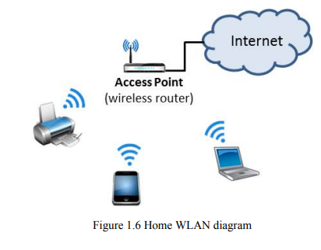
Wireless Local-Area Network (WLAN)
Typical range up to 100 meters
Are used mostly in home, school, computer laboratory, or office environments
This gives users the ability to move around within a local coverage area and still be connected to the network.
WLANs are based on IEEE 802.11standards, marketed under the Wi-Fi brand name.
Notes:
Wi-Fi is the radio signal sent from a wireless router to a nearby device, which translates the signal into data you can see and use. The device transmits a radio signal back to the router, which connects to the internet by wire or cable.
wireless fidelity,

Slide 33
Wireless Local-Area Network (WLAN)
The IEEE 802.11 is a family of different standards for wireless local area networks.
The IEEE 802.11b was the first accepted standard, supporting up to 11 Mbps in the 2.4 GHz unlicensed spectrum band.
Then, the IEEE 802.11g standard was designed as a higher-bandwidth successor to the IEEE 802.11b.
An IEEE 802.11g access point will support 802.11b and 802.11g clients.
Similarly, a laptop with an IEEE 802.11g card will be able to access existing 802.11b access points as well as new 802.11g access points.
The maximum transfer rate for the IEEE 802.11g wireless link is 54 Mbps, but it will automatically back down from 54 Mbps when the radio signal is weak or when interference is detected.
Notes:
Wireless LANs provide high-speed data within a small region, e.g. a campus or small building, as users move from place to place. Wireless devices that access these LANs are typically stationary or moving at pedestrian speeds.
It operates at a maximum net data rate from 54 Mbit/s to 600 Mbit/s.
In WLAN, wireless adapters provide the interface between the network operating system and an antenna to create a transparent connection to the network.

Slide 34
Wireless Local-Area Network (WLAN)
In WLAN, wireless adapters provide the interface between the network operating system and an antenna to create a transparent connection to the network.
Ethernet is widely used
Wireless LANs can operate in one of two configurations,
With a base station is known as infrastructure-based wireless networks
Without a base station is known as Ad hoc networking .

Slide 35
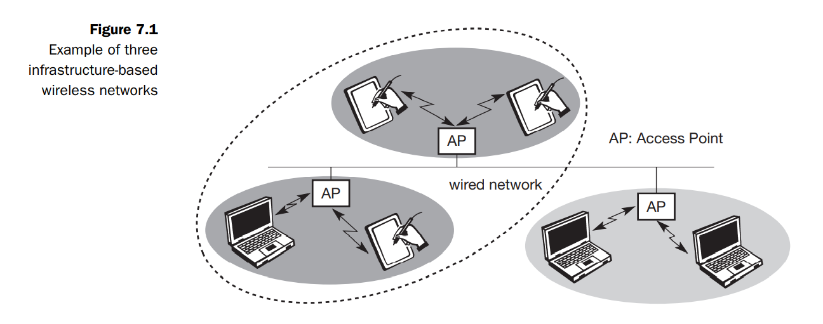
Infrastructure-based wireless networks
The last link with the users is wireless, to give a network connection to all users in a building or campus.
The backbone network usually uses cables
Infrastructure networks not only provide access to other networks, but also include forwarding functions, medium access control etc.
In the infrastructure-based wireless networks, communication typically takes place only between the wireless nodes and the access point, but not directly between the wireless nodes.

Slide 36
Infrastructure-based wireless networks
The access point does not just control medium access, but also acts as a bridge to other wireless or wired networks.
Figure 7.1 shows three access points with their three wireless networks and a wired network.
Several wireless networks may form one logical wireless network, so the access points together with the fixed network in between can connect several wireless networks to form a larger network beyond actual radio coverage.
This type of network is reminiscent of switched Ethernet or other star-based networks, where a central element (e.g., a switch) controls network flow.

Slide 37
Infrastructure-based wireless networks
This type of network can use different access schemes with or without collision. Collisions may occur if medium access of the wireless nodes and the access point is not coordinated. However, if only the access point controls medium access, no collisions are possible. This setting may be useful for quality of service guarantees such as minimum bandwidth for certain nodes.
Infrastructure-based networks cannot be used for disaster relief in cases where no infrastructure is left.
Typical cellular phone networks are infrastructure-based networks for a wide area. Also satellite-based cellular phones have an infrastructure – the satellites.

Slide 38
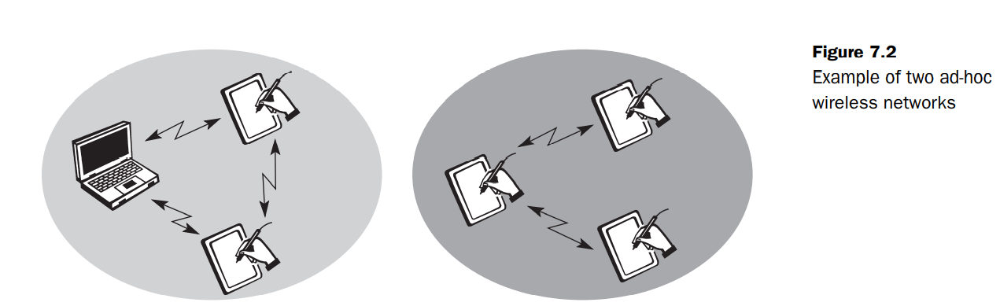
Ad-hoc network.
Each user in the wireless network communicates directly with all others, without a backbone network sometimes called ad-hoc network. This type of network do not need any infrastructure to work. So no access point controlling medium access is necessary.
Figure shows two ad-hoc networks with three nodes each. Nodes within an ad-hoc network can only communicate if they can reach each other physically, i.e., if they are within each other’s radio range.
Nodes from the two networks shown in the figure cannot communicate with each other as they are not within the same radio range.

Slide 39
Ad-hoc network.
In ad-hoc networks, the complexity of each node is higher because every node has to implement medium access mechanisms, mechanisms to handle hidden or exposed terminal problems, and perhaps priority mechanisms, to provide a certain quality of service.
This type of wireless network exhibits the greatest possible flexibility as it is, for example, needed for unexpected meetings, quick replacements of infrastructure or communication scenarios far away from any infrastructure.
However, ad-hoc networks might only have selected nodes with the capabilities of forwarding data.

Slide 40
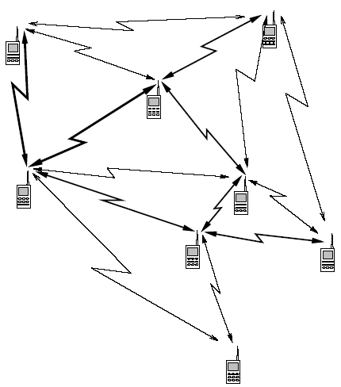
Ad-hoc network.
Most of the nodes have to connect to such a special node first to transmit data if the receiver is out of their range.
An ad hoc wireless network is a collection of wireless mobile nodes that self-configure to form a network without the aid of any established infrastructure.
Without an inherent infrastructure, the mobiles handle the necessary control and networking tasks by themselves, generally through the use of distributed control algorithms.

Slide 41
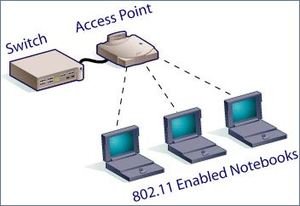
Benefits of Wireless LANs
People can access the network from where they want; they are no longer limited by the length of the cable.
Some cities have started to offer Wireless LANs. This means that people can access the internet even outside their normal work environment, for example when they ride the train.
Setting up a wireless LAN can be done with one box (called Access point). This box can handle a varying number of connections at the same time. Wired networks require cables to be laid. This can be difficult for certain places.
Access points can serve a varying number of computers using DHCP.
Dynamic Host Configuration Protocol (DHCP) is a protocol for assigning dynamic IP addresses to devices on a network. With dynamic addressing, a device can have a different IP address every time it connects to the network
Notes:
Dynamic Host Configuration Protocol (DHCP) is a protocol for assigning dynamic IP addresses to devices on a network. With dynamic addressing, a device can have a different IP address every time it connects to the network
Dynamic Host Configuration Protocol (DHCP) is a client/server protocol that automatically provides an Internet Protocol (IP) host with its IP address and other related configuration information such as the subnet mask and default gateway.
A Subnet mask is a 32-bit number that masks an IP address, and divides the IP address into network address and host address. Subnet Mask is made by setting network bits to all "1"s and setting host bits to all "0"s.

Slide 42
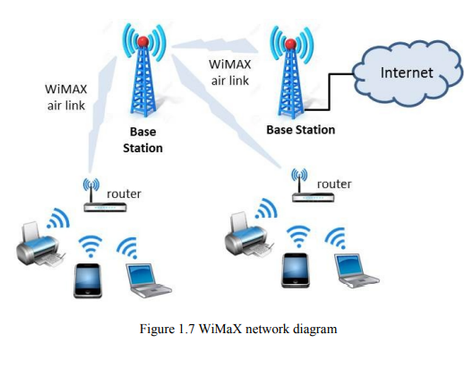
Wireless Metropolitan-Area Network (WMAN)
Wireless Metropolitan Area Networks (WMANs) are based on IEEE 802.16 standard which is often called WiMAX (Worldwide Interoperability for Microwave Access).
Supports point to multipoint architecture
Provides high-speed wireless data over metropolitan area networks
Smaller wireless LANs to be interconnected by WiMAX creating a large WMAN.
WiMAX is similar to Wi-Fi, but provides coverage over greater distances.

Slide 43
Wireless Metropolitan-Area Network (WMAN)
WiMAX operates on two frequency bands, a mixture of licensed and unlicensed band, from 2 GHz to 11 GHz and from 10 GHz to 66 GHz,
Transfer around 70 Mbps over a distance of 50 km to thousands of users from a single base station
Work by line-of-sight and non-line-of-sight.
At the 2 to 11GHz frequency range it works by non-line-of-sight, where a computer inside a building communicates with a tower/antenna outside the building.
Higher frequency transmissions are used for line-of-sight service. This enables to towers/antennae to communicate with each other over a greater distance.

Slide 44
Architecture of the LAN and MAN (WiFi- and WiMAX) integrated network
There may be several RSs (Relay Stations) in the coverage area of one WiMAX BS.
Each RS can establish a communication link with its BS and can serve several MSs in its signal coverage.
In addition, a RS can connect to multiple APs through wirelines (such as Ethernet, Fiber, etc.), that is, this RS serves as the access network of these APs.
A dual-mode MS may connect to an AP or establish a communication link with a RS.
Notes:
AP-Access points
Ethernet is a physical and data link layer technology for local area networks (LANs). Ethernet is a link layer protocol in the TCP/IP stack, describing how networked devices can format data for transmission to other network devices on the same network segment, and how to put that data out on the network connection.
Ethernet cables is limited to roughly 100 meters, but Ethernet networks can be easily extended to link entire schools or office buildings using network bridge devices.

Slide 45
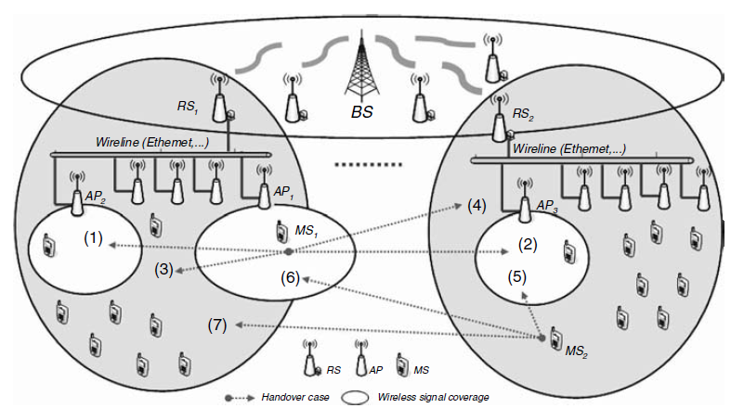
Relay Station (RS)
AP Access Point
Architecture of the LAN and MAN (WiFi- and WiMAX) integrated network

Slide 46
Wireless Wide-Area Network (WWAN)
Wireless Wide Area Networks extend beyond 50 kilometers and typically use licensed frequencies.
Over large areas, such as cities or countries, via multiple satellite systems or antenna sites are looked after by an internet services provider.
There are mainly two available technologies: Digital cellular telephony and Satellites

Slide 47
Wireless Wide-Area Network (WWAN)
Cellular telephone networks
In the cellular system, the coverage area is divided into cells. A cell transmitter, at center of the cell, is designed to serve an individual cell.
All transmitters are connected to a base station and these latter to a mobile telecommunications switching office which links the cellular and the wired telephone network.
The system seeks to make efficient use of available channels by using low-power transmitters to allow frequency reuse at much smaller distances.

Slide 48
Wireless Wide-Area Network (WWAN)
Different cellular generations have been developed since early 1980s. First generation, 1G, was analog and, conceived and designed purely for voice calls with almost no consideration of data services, with a speed of up to 2.4 kbps.
The second generation, 2G, was based on digital technology and network infrastructure (GSM), enabling text messages, and with a data speed of up to 64 Kbps.
The 2.5G generation was between the second and the third. Sometimes it has been referred as 2G + GPRS, it is an enhanced version of 2G, with a speed of up to 144 Kbps.
The 3G generation was introduced in year 2000, with a data speed of up to 2 Mbps.
The 3.5G is an enhanced version of the 3G that uses HSDPA to speed data transfers up to 14 Mbps.
Finally the fourth generation, 4G, is capable of providing up to 1 Gbps speed and any kind of service at any time as per user requirements, anywhere.
The 5G generation is expected by year 2020.
Notes:
GSM: GSM is a mobile communications system and means “Global System for Mobile Communications”. GSM supports data rates of max. 14.4 kbit / s
GPRS:GPRS is “General Packet Radio Service” and is a service between UMTS and GSM networks of permanent connection to devices sustains and transmits data packets only when necessary.
UMTS: “Universal Mobile Telecommunication System”. UMTS is a mobile system with speeds of max. 384 kbit / s UMTS is the successor of GSM and commercially available since 2004 in Germany.
HSDPA: HSDPA means “High Speed Downlink Packet Access” and is a technique used in the UMTS mobile communication system, the download speeds of currently 3.6 Mbit/s to 7.2 Mbit/s.
EDGE: means “Enhanced Data Rates for GSM Evolution” and is a transmission technique in GSM networks, the transmission rate can be increased theoretically up to 220 kbit/s. Enhanced Data Rates for GSM Evolution (EDGE) refers to a technique for increasing the data transmission rate in GSM networks by introducing an additional modulation method

Slide 49
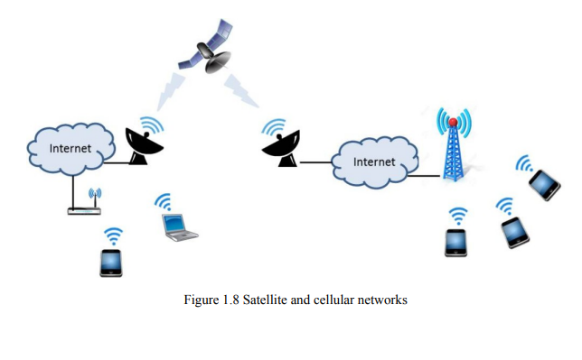
Wireless Wide-Area Network (WWAN)
Satellite Wireless communications can also be developed via satellite.
Due to its high altitude, satellite transmissions can cover a wide area over the surface of the earth.
This can be very useful for users who are located in remote areas or islands where no submarine cables are in service. In these cases, satellite telephones are needed.
Each satellite is equipped with various transponders consisting of a transceiver and an antenna. The incoming signal is amplified and then rebroadcast on a different frequency.
Notes:
Transponder performs the functions of both transmitter and receiver (Responder) in a satellite. Hence, the word ‘Transponder’ is obtained by the combining few letters of two words, Transmitter (Trans) and Responder (ponder).

Slide 50
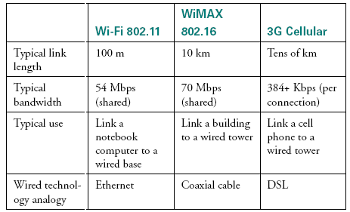

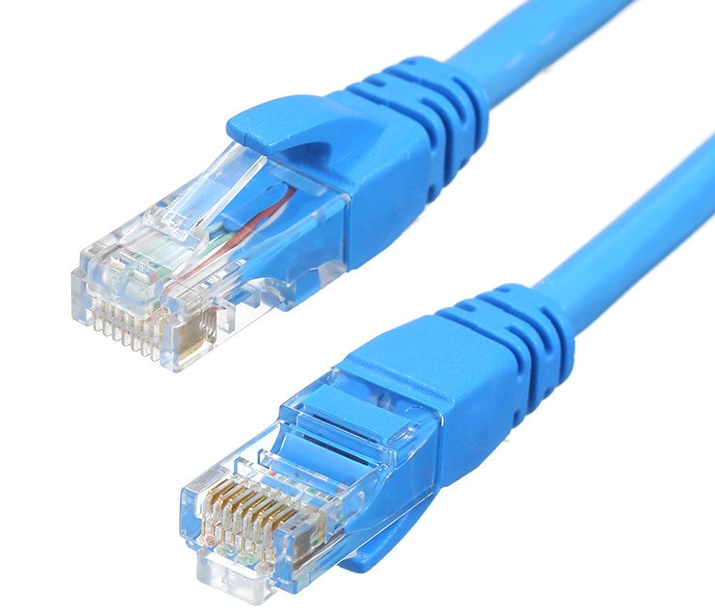
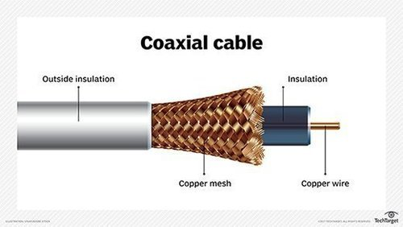
Four prominent wireless technologies: Bluetooth, Wi-Fi (more formally known as 802.11), WiMAX (802.16), and third-generation or 3G cellular wireless.
Notes:
WiMAX -Worldwide Interoperability for Microwave Access. It provides wireless internet service over longer distances than standard Wi-Fi. Interoperable implementations of the IEEE 802.16 family of wireless-networks standards. Wi-Fi-wireless fidelity- a facility allowing computers, smartphones, or other devices to connect to the Internet or communicate with one another wirelessly within a particular area. A cellular network or mobile network is a communication network where the last link is wireless. The network is distributed over land areas called cells, each served by at least one fixed-location transceiver, known as a cell site or base station. If a Wi-Fi network is unavailable, you can use a cellular data network to connect to the Internet on your iPhone and iPad.
DSL (Digital Subscriber Line) is a technology for bringing high- bandwidth information to homes and small businesses over ordinary copper telephone lines

Slide 51
Wireless LAN Technologies
Wireless LAN technologies can be classified into four types:
Infrared
Narrowband RF
Spread-spectrum
Home RF and Bluetooth.

Slide 52
Infrared LANs
Each signal-covering cell in an infrared LAN is limited to one room. Coverage is small, since the infrared rays cannot penetrate through wall and other opaque obstacles. The primary difference between infrared and radio wireless LANs is the frequency of the transmitted signal. 802.11a and 802.11b operate in the 2.4 and 5GHz bands respectively, but infrared systems use frequencies in the terahertz range.
The use of infrared has several advantages. For example, the bandwidth for infrared communication is large and can therefore achieve high data rates. Also, because infrared rays are reflected by lightly colored objects, it is possible to cover the entire area of the room with reflections from objects. Since infrared cannot penetrate through walls and other opaque obstacles, it becomes very difficult for any adversary to carry out a passive attack or to eavesdrop. Hence, communication with infrared technology is more secure. Also, separate infrared networks can be used in adjacent rooms without any interference effects. Finally, equipment for infrared communication is much cheaper than microwave communication. The one major disadvantage of infrared technology is that background radiation from sunlight and indoor lighting can cause interference at the infrared receivers.
Notes:
Infrared at 1 Mbps and 2Mbps operates at wavelength between 850nm and 950nm.
Infrared signals are placed in the light region invisible to the human eye.
Omnidirectional antenna, an antenna that radiates equally in all directions. omnidirectional
Diffuse mean spread out, or the action of spreading out.

Slide 53
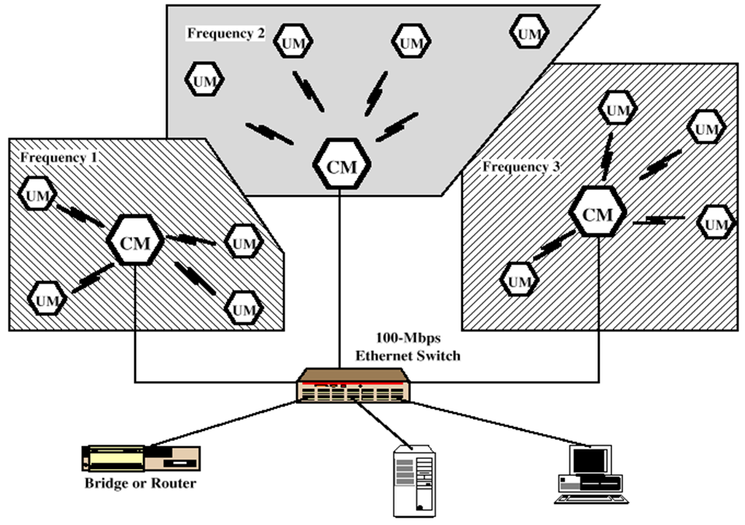
Narrowband RF LANs
Narrowband RF LANs use very narrow bandwidth.
Adjacent cells use different frequency bands.
The transmissions are encrypted to prevent attacks.
There are several Control Module (CM) to interface wireless LAN to the backbone Ethernet (wired LAN).
In the figure each cell has its own CM and connected by a switch to route traffic among them.
UM→ User Module
Notes:
Narrowband is usually considered to cover frequencies 300–3400 Hz.
Narrowband Microwave LANs: Licensed Narrowband RF Licensed narrowband LAN guarantees interference-free communication
UnLicensed Narrowband RF This spectrum can be used for narrowband transmission at low power (<0.5 W). The product operates at 10 Mbps in the 5.8 GHz band and has a range of 50 m in a semi-open office and 100 m in an open office.
Wired Equivalent Privacy (WEP) - a low-level data encryption system – was invented for wireless security purposes. WEP protocol protects link level data during wireless transmission between clients and access points. It does not provide end-to-end security, but only for the wireless portion of the connection

Slide 54
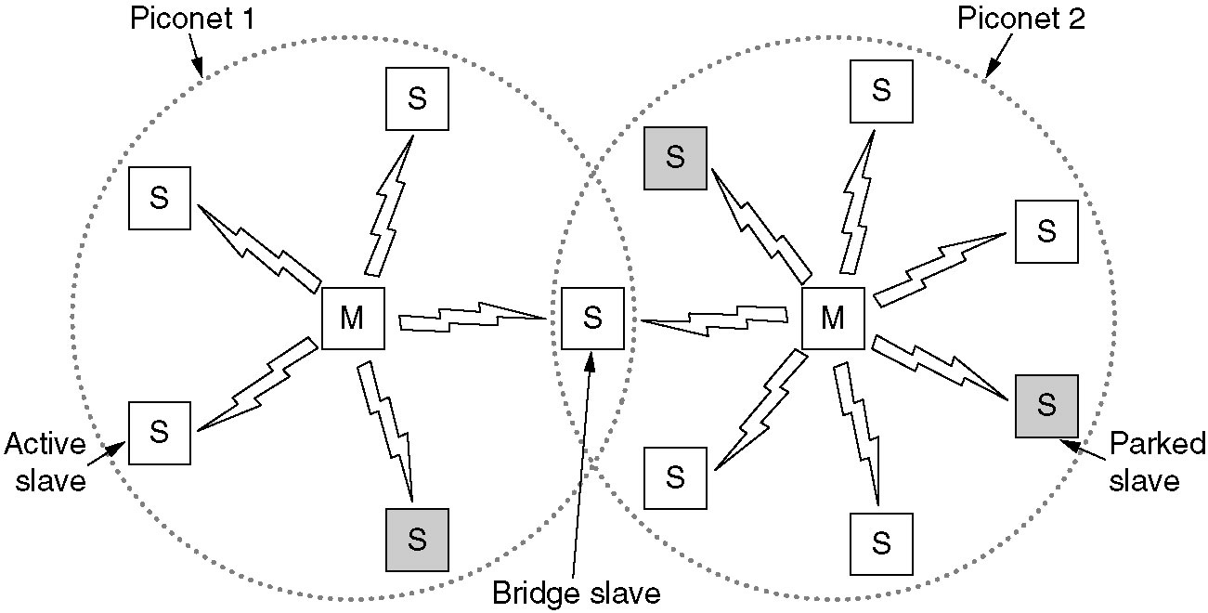
Home RF and Bluetooth
Home RF supports data rates of about 2Mbps and has range of about 50m.
Bluetooth is a wireless LAN technology designed to connect devices of different functions such as telephone, notebooks, computers, cameras, printers etc.
Bluetooth defines two types of networks called: piconet and scatternet.
A piconet can have up to eight stations, one of which is called primary station, the rest are called secondaries. All the secondary stations synchronize their clocks and hopping sequence with the primary. Bluetooth uses frequency-hopping spread spectrum (FHSS) in the physical layer to avoid interference from other devices or network.
Notes:
Piconets have a 7 member address space (3 bits, with zero reserved for broadcast), which limits the maximum size of a piconet to 8 devices, i.e. 1 master and 7 slaves.
A scatternet is a number of interconnected piconets that supports communication between more than 8 devices. Scatternets can be formed when a member of one piconet (either the master or one of the slaves) elects to participate as a slave in a second, separate piconet. The device participating in both piconets can relay data between members of both ad hoc networks. However, the basic Bluetooth protocol does not support this relaying - the host software of each device would need to manage it. Using this approach, it is possible to join together numerous piconets into a large scatternet, and to expand the physical size of the network beyond Bluetooth's limited range.
Currently there are very few actual implementations of scatternets due to limitations of Bluetooth and the MAC address protocol. However, there is a growing body of research being conducted with the goal of developing algorithms to efficiently form scatternets.
A number of companies have attempted to launch social networking and dating services that leverage early scatternet implementations (see Bluedating). Scatternets can also be used to enable ad hoc communication and interaction between autonomous robots and other devices.

Slide 55
Piconets can be combined to form scatternet where a secondary user of one piconet acts as bridge to another piconet. The bridge secondary/slave acts as a primary in receiving packets from the original primary of first piconet then deliver the packet to secondaries of the second piconet.
Although a piconet can have maximum 7 secondaries , additional secondaries can be in parked state. A seconadry in parked state is synchronized with the primary, but can not take part in communication until it is removed from parked state to the active state.
Notes:
Let's say you have a typical modern living room with typical modern stuff inside. There's an entertainment system with a stereo, a DVD player, a satellite TV receiver and a television; there's also a cordless telephone and a personal computer. Each of these systems uses Bluetooth, and each forms its own piconet to talk between the main unit and peripheral.

Slide 56
Two types of links can be created between primary and secondary:
A synchronous connection-oriented (SCO) link is used when avoiding latency (delay in data delivery) is more important than integrity (error free delivery) for example real time audio. If a packet is damaged it is never retransmitted.
An asynchronous connectionless link (ACL) is used when data integrity is more important than avoiding latency. In this type link if payload encapsulated in the frame is lost/ corrupted, it is retransmitted.

Slide 57
Layers of Bluetooth
Application Layer
L2CAL layer
Baseband layer
Radio Layer
Radio layer is like physical layer of Internet. Uses FHSS, GFSK modulation.
Baseband waveform is passed through a Gaussian filter to make the transitions smoother so to limit its spectral width.
Baseband layer is like MAC sublayer uses TDMA slot as the physical channel.
Time-division multiple access (TDMA) is a channel access method for shared-medium networks.
It allows several users to share the same frequency channel by dividing the signal into different time slots.
The users transmit in rapid succession, one after the other, each using its own time slot.
Logical Link Control and Adaption Protocol (L2CAP) is like LLC sublayer.
The LLC layer is concerned with managing traffic (flow and error control) over the physical medium
Applications Layer − This includes the application profiles that allow the user to interact with the Bluetooth applications.
Notes:
A GFSK modulator differs from a simple frequency-shift keying modulator in that before the baseband waveform (levels −1 and +1) goes into the FSK modulator, it is passed through a Gaussian filter to make the transitions smoother so to limit its spectral width.
Time-division multiple access (TDMA) is a channel access method for shared-medium networks. It allows several users to share the same frequency channel by dividing the signal into different time slots. The users transmit in rapid succession, one after the other, each using its own time slot.
The LCL layer is concerned with managing traffic (flow and error control) over the physical medium. The LCL layer also identifies a line protocol, such as SDLC, NetBIOS, or NetWare, and may also assign sequence numbers to frames and track acknowledgements. It accepts packets up to 64 kB from upper layer and breaks into frames for transmission.
LLC, that interacts with the Application layer above and the lower sub-layer, termed as MAC, that interacts with the physical layer below.
LLC, that interacts with the network layer above and the lower sub-layer, termed as MAC, that interacts with the physical layer below

Slide 58
Thank You

